Slide 1
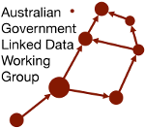


Australian Government Linked Data Working Group 2023 Linked Data Showcase
Notes:
Title

Slide 2
Australian Government Linked Data Working Group 2023 Linked Data Showcase
Presentation program
AGLDWG’s Linked Data IRI service Nicholas Car (AGLDWG), Richard Walker (Australian Research Data Commons)
Linked Data for Digital Humanities Terhi Nurmikko-Fuller (ANU)
National PID Strategy (Australian Research Data Commons)
Engineering on decentralized data using Personal Online Datastores Jess Moore (ANU)
Research Link Australia (Australian Research Data Commons)
Towards an Automated Knowledge Graph Construction Pipeline Bowen Zhang, Runsong Jia, Sergio J. Rodríguez Méndez (ANU)
Finance Knowledge Graph and structure.gov.au John Machin (Department of Finance)
Notes:
Program

Slide 3
Australian Government Linked Data Working Group 2023 Linked Data Showcase
Presentation program cont.
Indigenous Data Network LD Tooling Jamie Feiss (University of Melbourne)
Queensland’s Address Linked Data conversion Edmond Chuk (KurrawongAI, working for the Qld Dept of Resources)
Notes:
Program cont.

Slide 4
AGLDWG Linked Data IRI Service
Status report for 2023 AGM, 2023-09-14
Richard Walker
AGLDWG Linked Data IRI service
Notes:
AGLDWG services

Slide 5
Operating the existing infrastructure
ARDC Services team now monitor the Registry (a.k.a. Catalogue, https://catalogue.linked.data.gov.au/) for new users and IRI requests.
Settings and processes being progressively applied to Rewriter GitHub repository to implement a staging process.
Revived the Rewriter test suite, and synchronized hundreds of test cases with the existing rewrite rules.
Rewriter test suite automation integrated with GitHub, including ticks/crosses and links to test results (see, e.g., https://github.com/AGLDWG/pid-proxy/commits/staging).
Improved “tombstoning” of legacy hosts (environment.data.gov.au, etc.).
Coming soon: automated deployment of rewrite rules to production.
AGLDWG Linked Data IRI service
Notes:
Blank Text Slide

Slide 6
Developing new infrastructure
Coming soon: new WG mailing list (replacing CSIRO Mailman) and co-chairs address.
Registry: preparing for migration to Drupal 10 (and 11).
New server infrastructure: working with our local provider on some final (?) network setup, and developing automation of the server provisioning.
AGLDWG Linked Data IRI service
Notes:
Blank Text Slide

Slide 7
Notes:
Thank you slide

Slide 8

Australian Government Linked Data Working Group 2023 Linked Data Showcase
Linked Data for Digital Humanities Terhi Nurmikko-Fuller (https://orcid.org/0000-0002-0688-3006)
Linked Open Data for Digital Humanities provides insights into how digital technologies can enrich and diversify humanities scholarship and make it pioneering in the digital age.
Linked Open Data for Digital Humanities discusses technological issues in the context of Humanities scholarship, bridging disciplines and enabling informed conversations across disciplinary boundaries. It will be of interest to humanities scholars, computer and data scientists, and library and information scientists.
Notes:
LD for Digital Humanities

Slide 9

Australian National PID Strategy
AGLDWG meeting
14 September 2023
PRESENTED BY
Natasha Simons

Slide 10
Notes:
Acknowledgement of Country

Slide 11

Why a National PID Strategy?
Exponential growth in data
The elements supporting the research lifecycle are often siloed, difficult to find or access
Leads to replication, duplication, barriers to cross-disciplinary research and challenges reproducibility
Leads to administrative burden and unnecessary cost
Deriving insights requires machine-readability (FAIR)
Whilst PIDs can’t make people share data, they can make it easy for them to do so and in a way that can create real value, improve research integrity and attribution

Slide 12
Strategic Value Proposition
Why a National PID Strategy?
Managing data across the research and innovation ecosystem can
Fuel research excellence
Drive innovation
Increase impact and
Deliver greater agility, transparency and administrative efficiency
Persistent Identifiers are a critical component of a world-leading national information infrastructure
Notes:
Blank Text Slide

Slide 13

Strategic Value Proposition
Why a National PID Strategy?
Report found that use of PID investment could save:
Nearly 38,000 person days per year (total time cost of rekeying metadata about grants, publications and projects )
Nearly $24 million per year (direct financial cost of this wasted effort).
Accounting for the opportunity cost associated with technology transfer and innovation-led growth suggests a far higher figure of $84 million per year.
Summarised recommendation:
Develop a national PID strategy for Australia based on ‘priority PIDs’
Notes:
Blank Text Slide

Slide 14

Why a National PID Strategy?
A national conversation to create a strategy that delivers shared value
for all stakeholders
A Roadmap built upon shared action
and accountability
Notes:
Blank Text Slide

Slide 15
What is the vision?
The vision is to accelerate Australian research quality, efficiency and impact through universal use of connected persistent identifiers, realised through a national conversation to create a strategy that delivers shared value for all stakeholders and a Roadmap built upon shared action and accountability.

Slide 16





What are the components and timeline?
INPUTS
PROCESS
OUTPUTS
National PID Strategy Taskforce (senior stakeholders)
Working Groups
National workshops
Stakeholder group workshops
Webinars
Individual submissions
National PID service providers (AAF, ARDC)
Iterative process
National PID Strategy Taskforce
National PID Strategy
5 year Roadmap
Individual, group, WG, org submit responses
Workshops, events etc.
February 2023 - November 2023

Slide 17


Roadmap update

Slide 18
Capability Maturity Model update - Funders example
Integrate ORCID into grant management system
Query ORCID API to pre-populate grant submissions
Write successful grants to ORCID records
Reducing administrative burden for researchers

Slide 19

How can you contribute?
We invite your feedback on the draft Strategy and your participation in contributing to the development of an accompanying Roadmap through any of the following:
Review the draft Strategy and provide your feedback
Send in a submission
Join an open webinar or event
Book a workshop for your team
Invite us to present at your event
https://ardc.edu.au/project/australian-national-persistent-identifier-pid-strategy-and-roadmap/

Slide 20
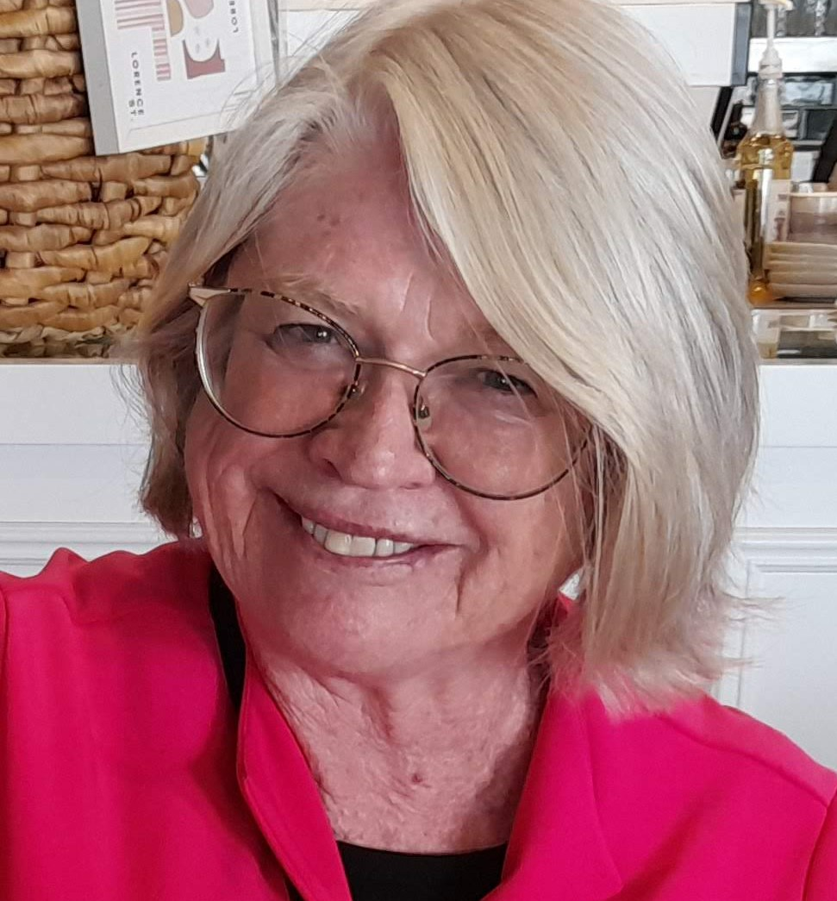


More info? Contact the National PID Strategy team
Linda O’Brien
Consultant and Project Lead, National PID Strategy
Natasha Simons
Director, National Coordination, ARDC
Matthias Liffers
Research Data Specialist (Informatics)
Notes:
Multiple Speakers with details

Slide 21
About the ARDC

Slide 22
Engineering on decentralized data using Personal Online Datastores
Speakers: Dr Jess Moore
September 2023
Notes:
Outline
The why and what of Solid Personal Online Datastores (PODs)
Technology behind Solid PODs
Building pipelines with existing systems
Health project with Yarrabah Indigenous community
Challenges

Slide 23



Solid PODs
Solid (Social linked data) is a specification that lets individuals store their data securely in decentralised data stores called PODs, that can host any type of data (https://solidproject.org/)
Using Resource Description Framework (RDF) serialization, data is stored in Turtle² in PODs
Multiple open source Solid servers are available
Community Solid Server PHP Solid Server (https://github.com/pdsinterop/php-solid-server), or a Solid server as a plugin for Nextcloud (https://github.com/pdsinterop/solid-nextcloud)
Individuals (and other data owners) can grant or revoke access to any part of their data knowledge graph at any time, and have logs recording access granted and terms
POD1
Backend x
App x
App x
POD2
Backend y
App y
POD3
App y
POD4
Centralised – Siloed backend for each app
Decentralised – All apps to same PODs
Notes:
Solid (Social linked data) is a web decentralisation project led by Sir Tim Berners-Lee.
He was motivated by the increasing centralization of data across the internet and conceived the Solid project as a first step to fix it.
Solid was first released in 2016, over the last 5 years, with increasing violations of user privacy, Solid has been gaining traction as one of the only technologies with potential to restore control and privacy of data, through governed data sharing across the internet.
You can find it at (https://solidproject.org/)
It contains a specification that lets individuals store their data securely in decentralised data stores called PODs, that can host any type of data
Multiple open source Solid servers are available
So why SOLID+PODS: Personal Online Datastore (POD) is a place where you can store your own personal data and have complete control over that data.
Individual as the first data user
Individuals can access their data in their POD, location for all their data – financial, health, personal, …
Individuals are better informed, and are better able to engage
Not just a datastore – an ecosystem for innovation – as data is stored and controlled separately to enterprise applications
Through development of open source components and standardised data structures: Entrepreneurs and developers quickly deliver new apps to support new enterprises built on data sharing applications in communities.
Apps to add innovative value to our personal Administrative Data
Trusted data stores to improve lives with trusted local apps/agents for my interests
Eg: Personal Health Apps supporting individuals and health professionals
Data Structure
Using Resource Description Framework (RDF) serialisation called Turtle² is used to express data in PODs
Turtle file data is represented in semantic triples: i.e. subject, a predicate, and an object, eg. <Bob> <birthday> <1988/02/16>
<Bob> <married to> <Alice>
<Alice> <is from> <Japan>
Data sharing
Files and pods are identified by the unique URI of the resource. Each entity has a WebID - An HTTP URI to identify person or organisation, uniquely
Authentication: OpenID Connect Solid server is used to verify the identity of data requesting parties and end users
Authorisation: identified users can be authorized various forms of access to resources via WebAccessControl (WAC)¹ ontology
Where access to resources can be granted and revoked at anytime by the data owner
Transparent metadata (logs) can be used for records and terms of access
Access Control Lists (ACLs)² are used to define access controls granted to users

Slide 24
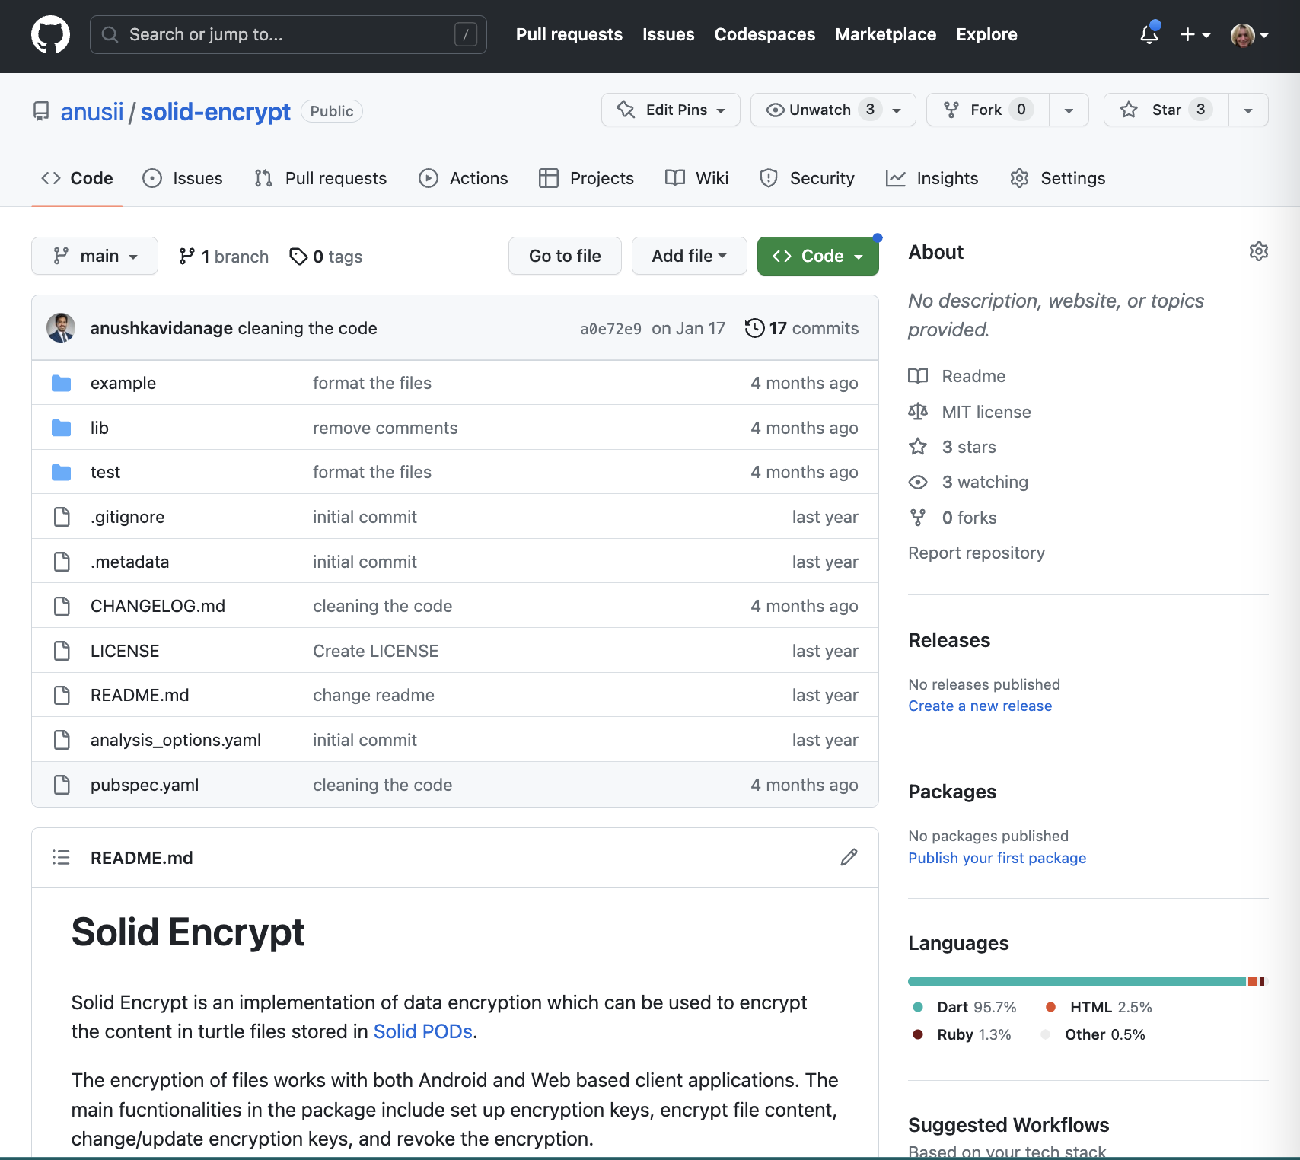
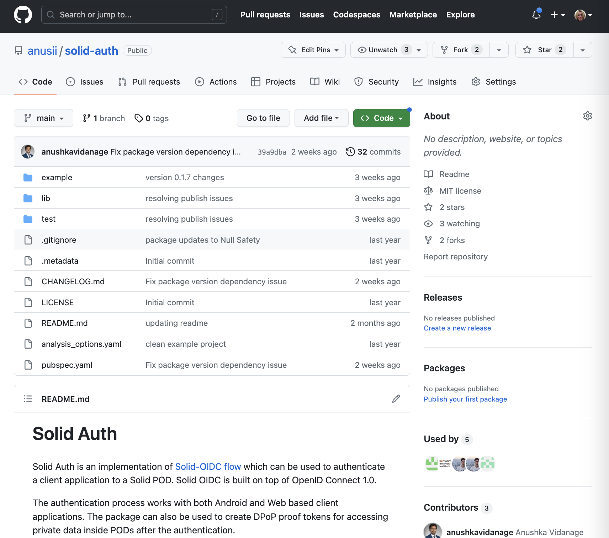
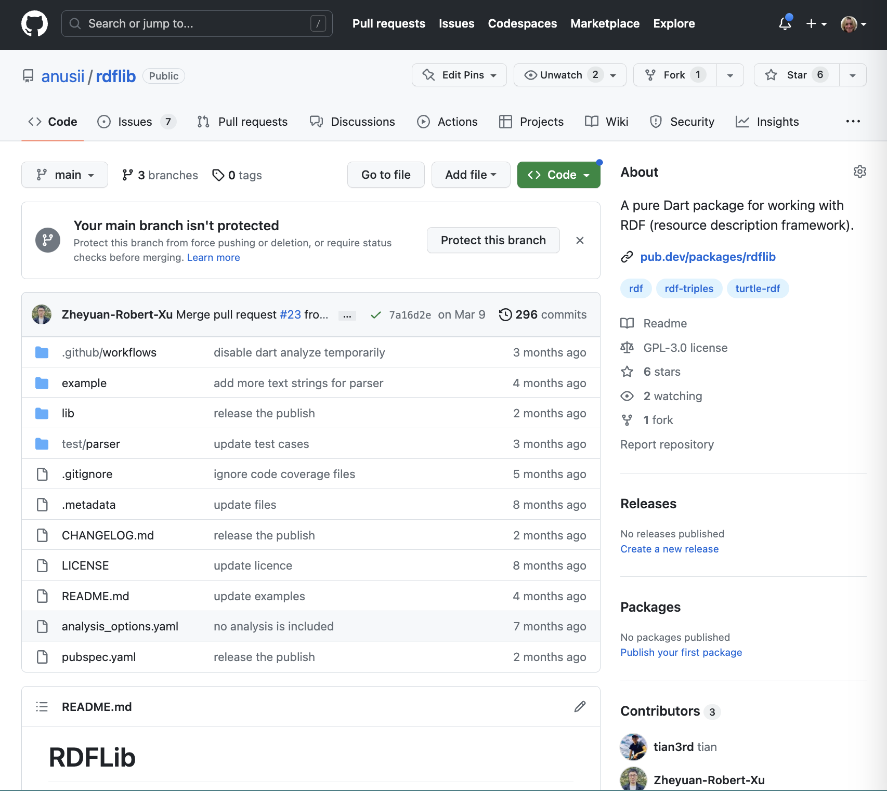
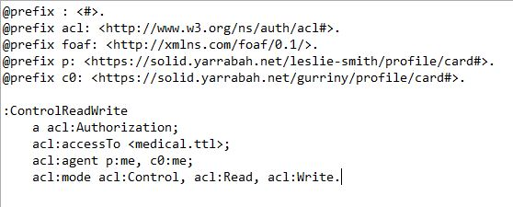
Engineering a better future
Communities, collaborations, and private enterprises can develop PODs based data applications, be involved in data standards and access control policies development
Community Solid Server https://github.com/CommunitySolidServer/CommunitySolidServer/)
solid-auth Solid-OIDC to authenticate (https://pub.dev/packages/solid_auth)
solid-encrypt- encrypting turtle files on PODs (https://pub.dev/packages/solid_encrypt)
rdflib – working with RDF turtle files in dart (https://pub.dev/packages/rdflib)
Sporting Club App
Community Data App
Health Service App
App x
Arts Club App
Personal Health app
Notes:
Today, developers can develop applications on PODs
Community Solid Server https://github.com/CommunitySolidServer/CommunitySolidServer/) which has many features of the enterprise solid server (developed by Inrupt)
solid-auth Solid-OIDC to authenticate (https://pub.dev/packages/solid_auth) Implementation of Solid-OIDC flow which can be used to authenticate a client application to a Solid POD. Solid OIDC is built on top of OpenID Connect 1.0.
solid-encrypt- encrypting turtle files on PODs (https://pub.dev/packages/solid_encrypt) Implementation of data encryption which can be used to encrypt the content in turtle files stored in a Solid POD.
rdflib – working with RDF turtle files in dart (https://pub.dev/packages/rdflib) A dart package for working with RDF. Features include find and create triple instances, create a graph to store triples, export graph to ttl, etc.
Communities, collaborations, and private enterprises can develop PODs based data infrastructure There’s a needs for data communities and the public to get involved in data standards and access control policies development To participate in trials using PODs based software. Currently we have 2 trials in development: 1. Developing Indigenous led data access control policies for data infrastructure and applications in an Indigenous community for PODs based software to support patients with chronic disease, and support Indigenous community leaders to collect evidence and act on social determinants. At the end of the trial, multiple community groups could have PODs based apps. This would allow patients to have their attendance at cultural, recreational, training and leadership activities shared to their POD.
2. A 5 year medical clinical trial developing personalised treatment of patients with depression using non-invasive low cost brain stimulation therapy that patients will be able to use in their homes, featuring dynamic consent and patient ownership of their medical data, allowing them to change their consent or more easily participate in other studies.
Optional: Challenges and Opportunities Many challenges, and lots of opportunities ahead.
1. Data migration and pipelines Organisational enterprise data systems are not yet being designed to work with knowledge graph data in RDF format. Consequently, there is still much work involved in migrating data between enterprise data bases and PODs.
2. Data security
Data is only decrypted on device, however that could expose data to back doors in the devices.
3. Trust & Consent
Consent models could share data with the proviso that once access is revoked it must be deleted. Future challenges include how we design and implement the right to be forgotten.
Currently, we depend on trust when we ask that our data is not further used and deleted after it is used for the consented purpose or after access has been revoked.
Finally, the consent models for data sharing need to be simple to understand, use and feasible to build.
Consent is not consent if we as the individuals participating in an activity do not understand or are not able to review what we have consented.
We also need to be able to implement it when the data is encrypted to ensure data is protected.
Working with Indigenous communities who’s First Nations knowledge includes strong understanding of data governance, the notion that access to data is earned, we can design and build the consent model that supports integrated care, distributed governance to support communities to have control over their data.

Slide 25
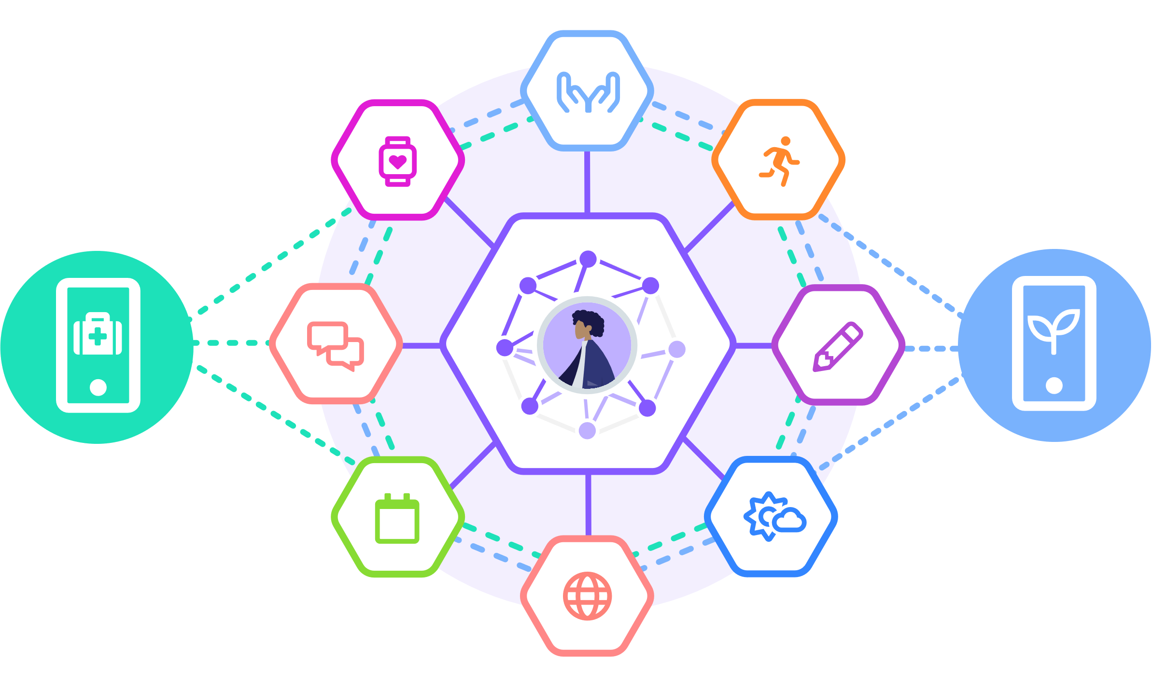
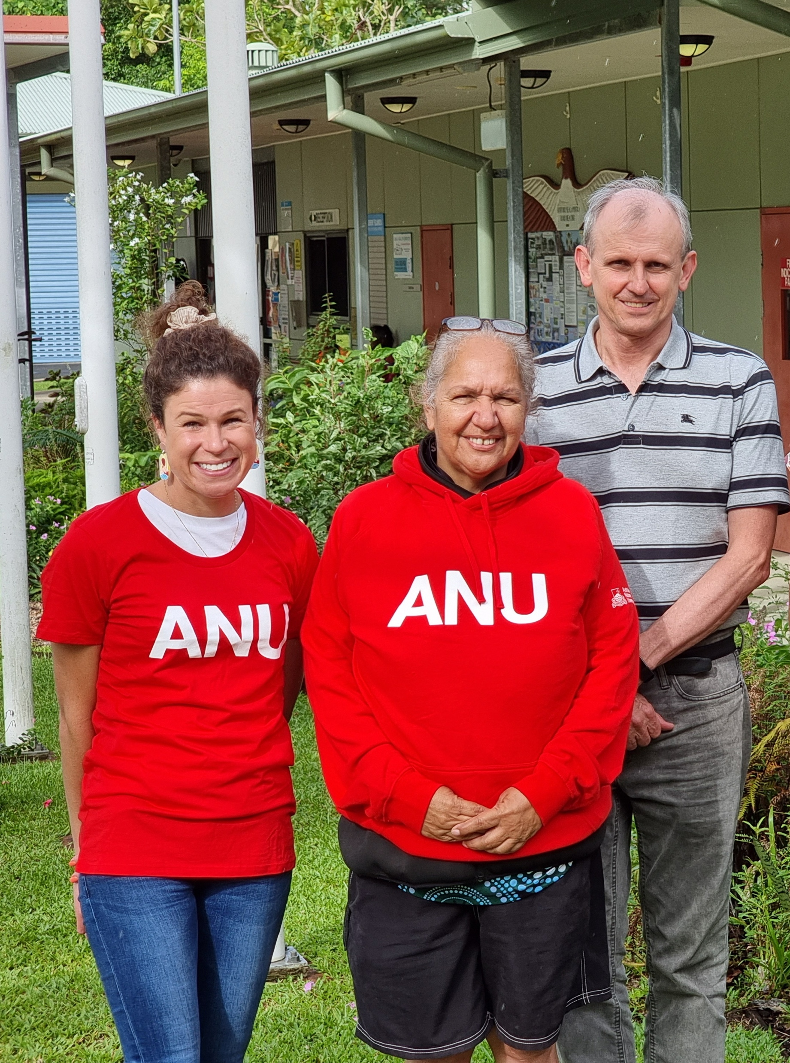
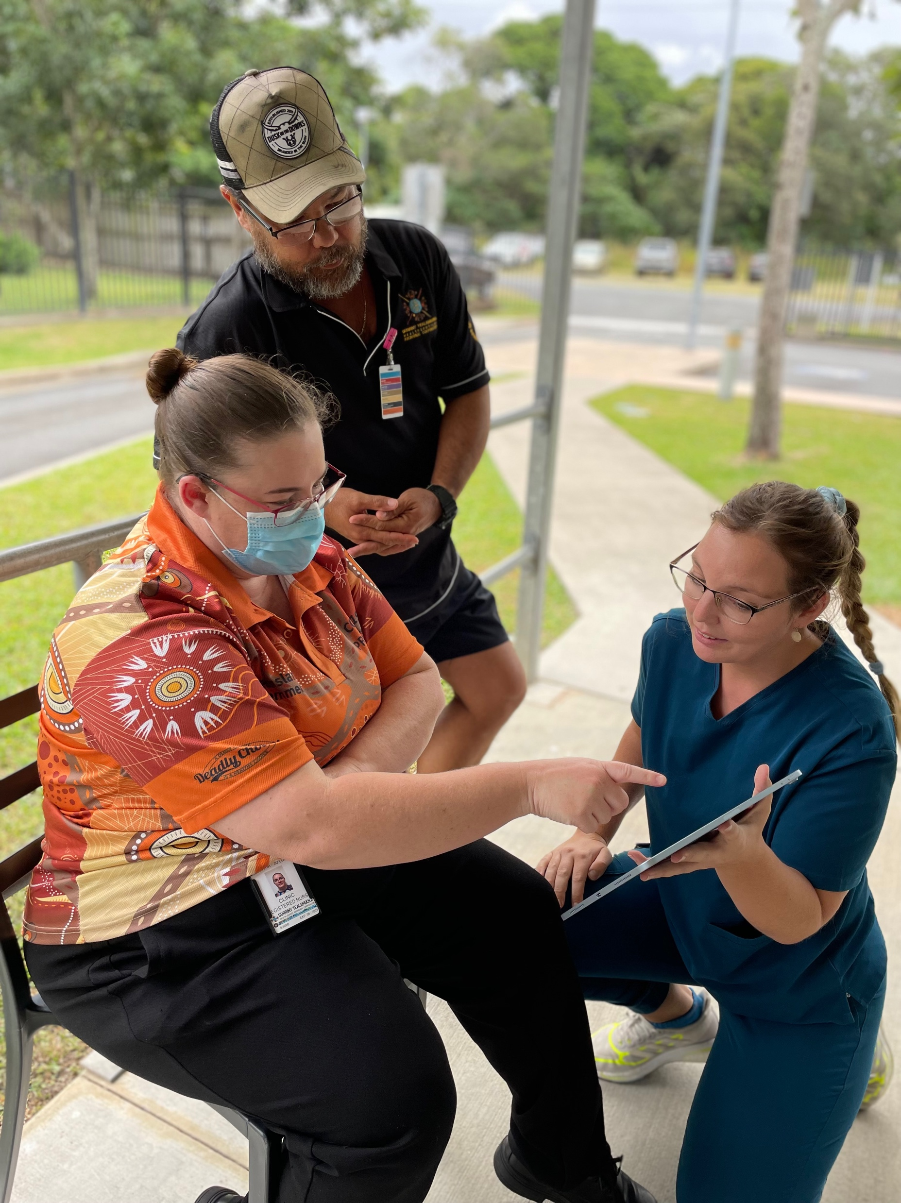
Source: https://solidproject.org/
Get involved! https://sii.anu.edu.au
Thank you from our team:
Prof Graham Williams, Dr Jason King (Gurriny Yealamucka Health Service), Dr Anushka Vidanage, Dr Sergio Rodriguez Mendez, Ninad Bhat, Zheyuan Xu, Tony Dr Jess Moore (ANU)
Contact: jessica.moore@anu.edu.au
Source: https://solidproject.org/
Notes:
We encourage people to get involved to help us create a future where we own and can control our data. Here is some of the team involved.
Dr Jason King, director of Clinical Services at Gurriny who had the vision for strength based care and data sharing in Yarrabah, and the clinical care teams in Gurriny.
Prof Graham Williams who leads this project and PODs based research in the ANU School of Computing, and the other team members of our team.

Slide 26
Australian Government Linked Data Working Group 2023 Linked Data Showcase
Research Link Australia (Australian Research Data Commons)
What is the challenge? Collaboration among research, industry, business and government is critical for innovation in Australia. It drives productivity, economic growth, improves quality of living and planet health, and enables us to address some of the most pressing problems facing society, like healthcare and medicine, and food security. An important step to enable this collaboration is connection. Better connection will help researchers and innovators find the collaborators and resources they need.
What is next? The project will be focusing on a series of progressive co-design workshops over the coming months (dates to be released soon). We will seek opportunities to co-design around a small number of identified community areas. Some will focus on systemic information-ecosystem uplift, and some will work closely with national research initiatives. Co-design outcomes will inform the development of the RLA platform, our strategy framework, and our operating model
Learn more? https://ardc.edu.au/project/research-link-australia/ https://ardc.edu.au/wp-content/uploads/2023/05/rla-project-update-april-2023.pdf
Notes:
RLA placeholder slide

Slide 27
Towards an Automated Knowledge Graph Construction Pipeline — KGCP, DDM, PARSE, ASKG, KG-LLM
Bowen Zhang, Runsong Jia, Sergio J. Rodríguez Méndez
AGLDWG
07 September 2023

Slide 28
Outline
Motivation.
KGCP: Knowledge Graph Construction Pipeline.
DDM: Deep Document Model.
PARSE: Papers And Relationships Semantic Extraction.
ASKG: ANU Scholarly KG.
KG-LLM interactions.

Slide 29
Motivation

Slide 30


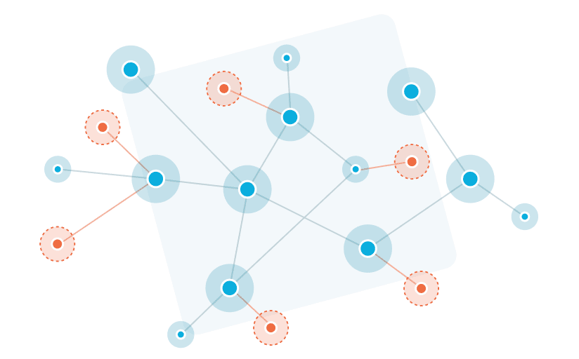





How?
Knowledge Graph
Heterogenous Data
{ metadata + content } →→→→ KG
Final goal: to build a contextual metadata KG from diverse documents using an automated pipeline
Notes:
[start]
From a heterogeneous dataset...
to the initial knowledge graph...
there are plenty of challenges to overcome...
How hard is it to automate the different tasks involved in this construction process?
Documents in an organisation ► document analysis ►Content in context.
Putting documents in context.
Metadata is at the core to understand the context.

Slide 31
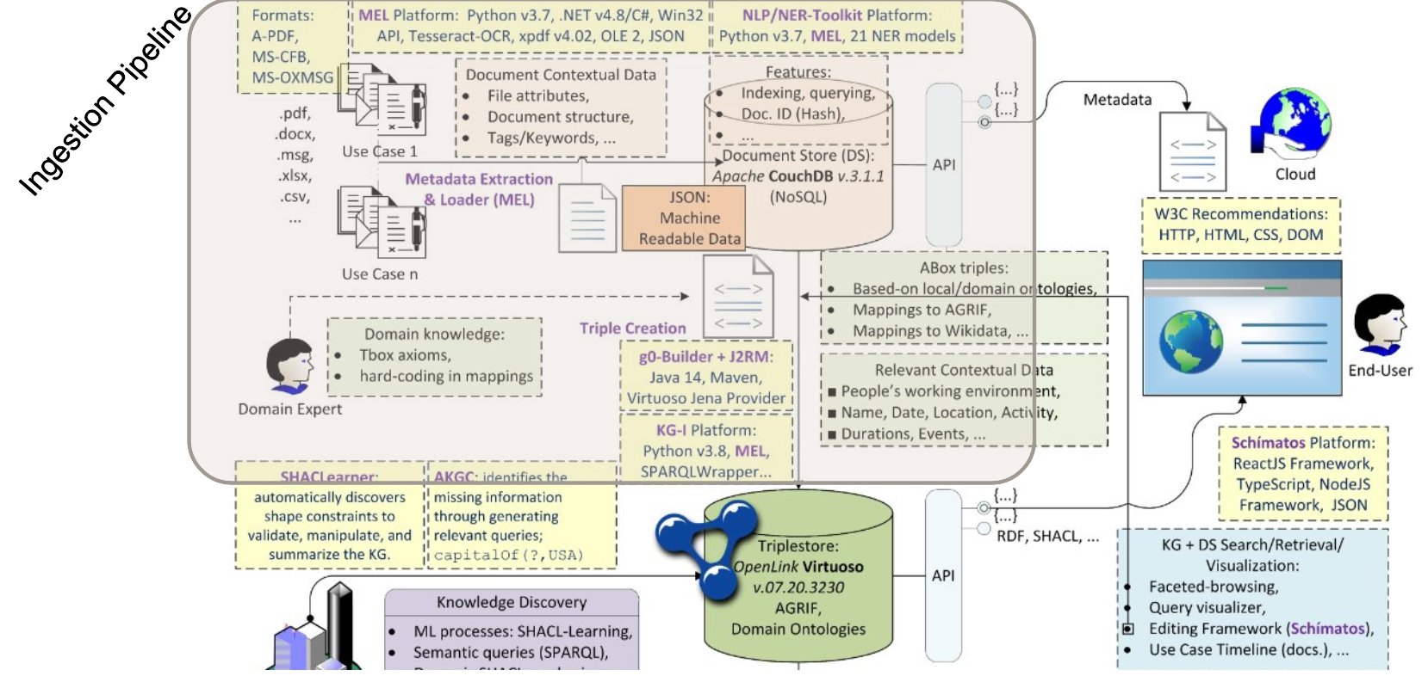
Resource: https://w3id.org/kgcp/
Knowledge Graph Construction Pipeline – KGCP

Slide 32
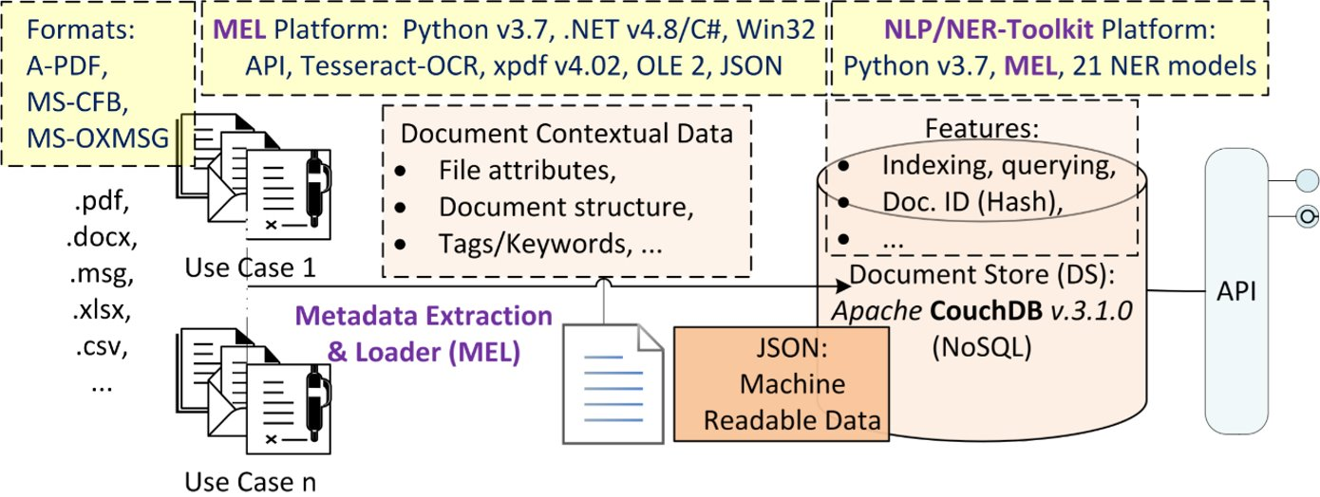
Paper: http://ceur-ws.org/Vol-2980/ Resource: https://w3id.org/kgcp/mel-tnnt
MEL: Metadata Extractor & Loader

Slide 33
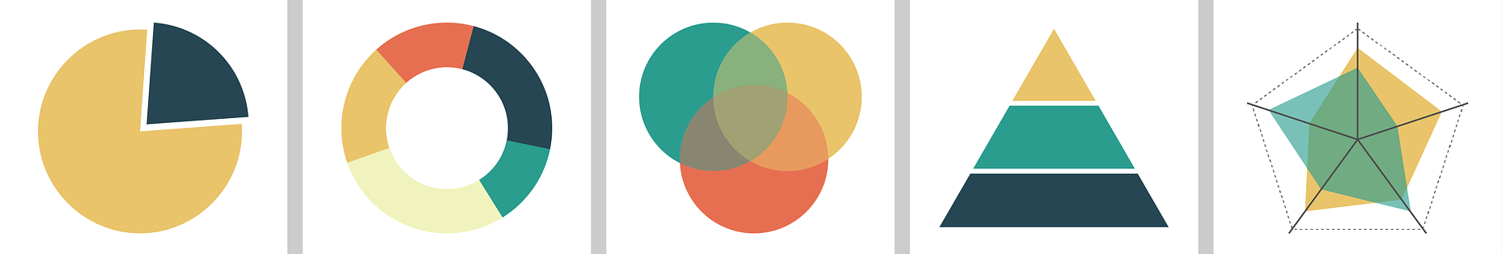
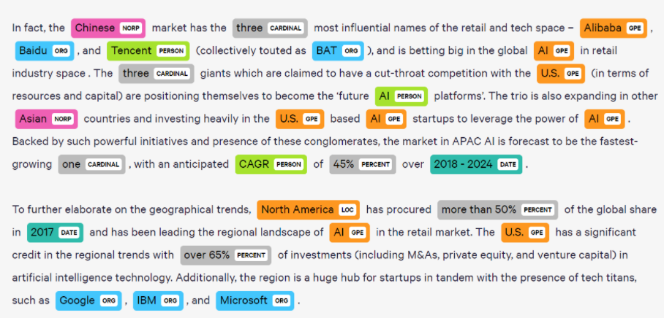
Paper: https://dl.acm.org/doi/10.1145/3460210.3493550 Resource: https://w3id.org/kgcp/mel-tnnt
TNNT: The NLP-NER Toolkit
Knowledge Graph Construction
Data Analysis
33

Slide 34









TNNT: Core Features
21 integrated SoTA NER models.
Models which can identify up to 18 categories.
Processing different models sequentially based on the input settings.
Hybrid processing data flow either from/to a document store or via direct processing from the file.
Integrated summary of the NER results.
A built-in RESTful API to browse, expand, complement, and co-relate the NER results.
# | Tool | No. Integrated Models
1 | NLTK [1] | 1
2 | [2] | 3
3 | Spacy | 3
4 | Stanza | 1
5 | Flair | 5
6 | Allen NLP | 2
7 | Polyglot | 1
8 | Deeppavlov | 4
9 | Bert-based [3] | 1
[1] Edward Loper and Steven Bird. 2002. NLTK: the Natural Language ToolKit.arXivpreprint cs/0205028(2002)
[2] Christopher D Manning, Mihai Surdeanu, John Bauer, Jenny Rose Finkel, Steven Bethard, and David McClosky. 2014. The Stanford CoreNLP natural language processing toolkit. In Proceedings of 52nd annual meeting of the ACL
[3] Jacob Devlin, Ming-Wei Chang, Kenton Lee, and Kristina Toutanova. 2018. Bert:Pre-training of deep bidirectional transformers for language understanding.arXiv:1810.04805(2018)
34

Slide 35
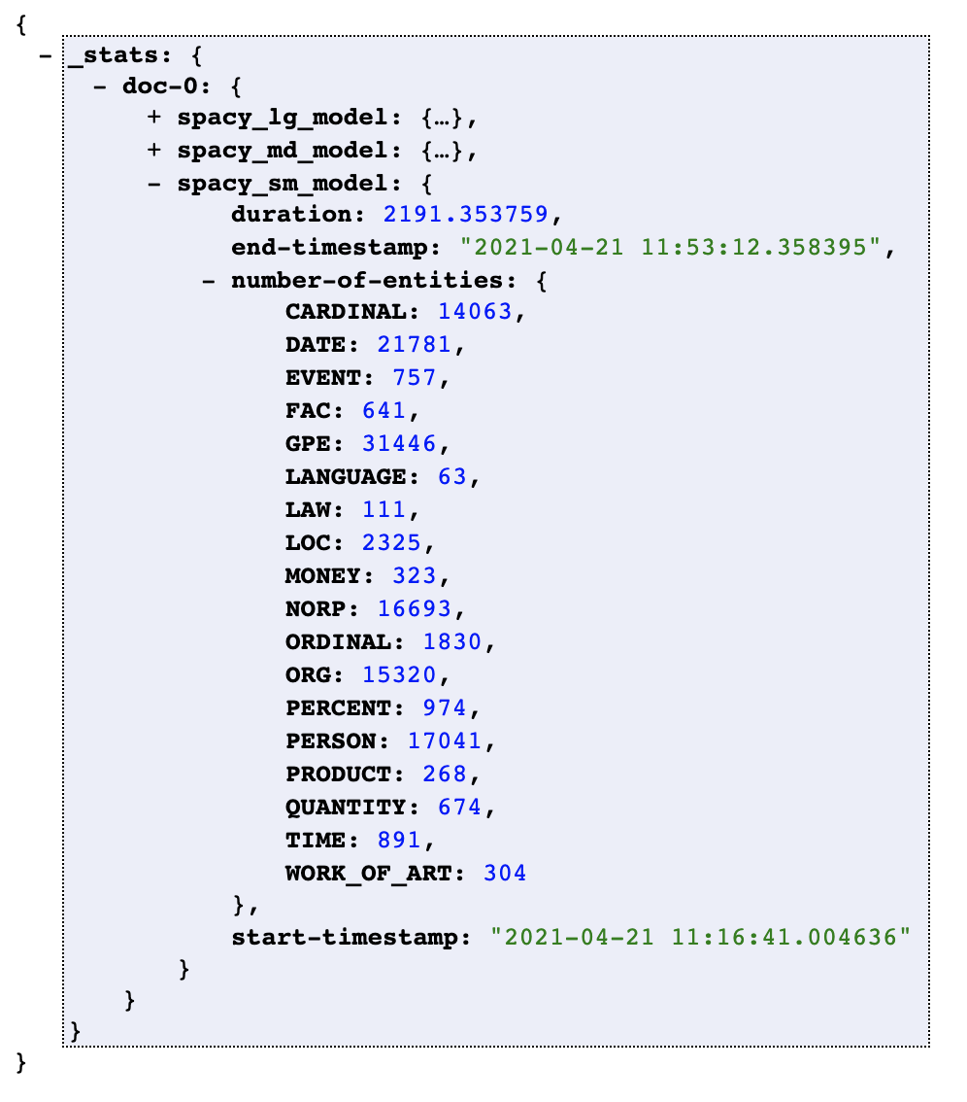
MEL+TNNT: Example
{
"_id": "1b9d05b641c93131c24be9077b274213",
"_rev": "1-064f0112d5c778174a00a8ca456821ef",
"General-Metadata": { ... },
"Use-Case$Folder": "",
"Specific-Metadata": { ... },
"Associated-Metadata": { ... },
"NLP-NER": {
"doc-0": {
"filename": "<FILENAME>",
//"General-Metadata": {
//"FILENAME": ""
//}
"Spacy-Model": { # one JSON object per model
"_output": { # group entities by their categories
"LOC": [ "entity 1", "entity 2", ... ],
"ORG": [ ... ],
...
},
"_stats": { # any other useful information about the processing
"start-timestamp": "2020-05-06T11:08:00",
"end-timestamp": "2020-05-06T11:09:00",
"duration": "60", # seconds
"number-of-entities": {
"LOC": 47,
"ORG": 84,
...
}
}
},
"Stanza-Model": { ... },
"BERT-Model": { ... }
},
"doc-1": { ...},
"doc-n": { ...}
},
"_attachments": { }
}
35
Notes:
Show an example!

Slide 36
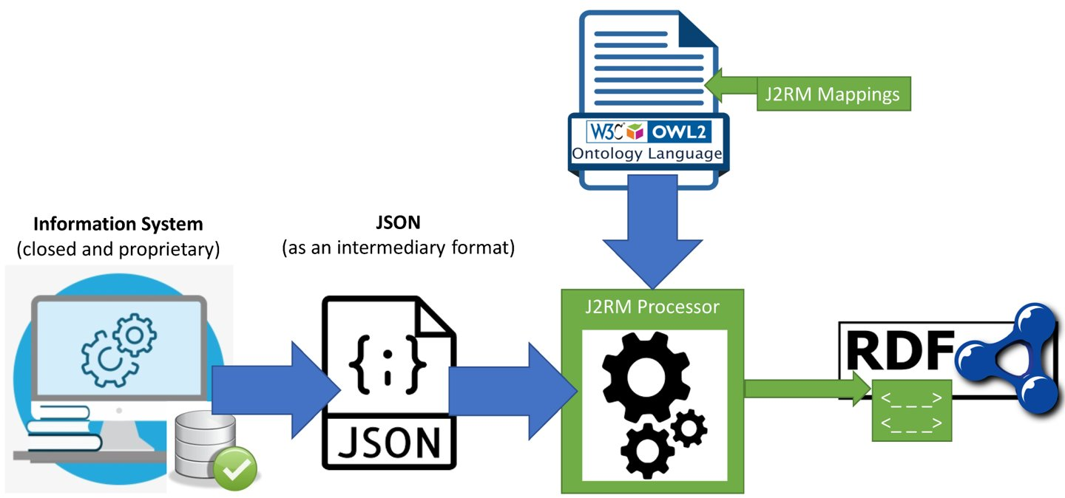
Paper: http://ceur-ws.org/Vol-2721/ Resource: https://w3id.org/kgcp/
J2RM: an Ontology-based JSON-to-RDF Mapping Tool

Slide 37
DDM:
Deep Document Model

Slide 38
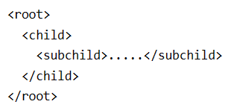
DDM Introduction
Purpose
Understand the logical structure of any document.
Key Points
(1) Identifies the logical structural components.
Recognised and outlined the basic structure so that we can see the document in a clean, easy-to-understand way.
(2) Works for all documents
Right now, we are focusing on academic papers, but it can work with all kinds of documents including recommendation letters or PowerPoint slides.
Inspiration
Applications
§ Document Similarity.
§ Document’s Anatomy.
XML DOM Example

Slide 39
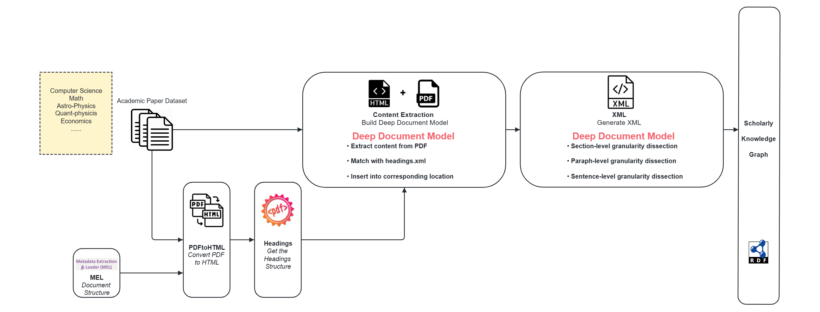
DDM Pipeline

Slide 40
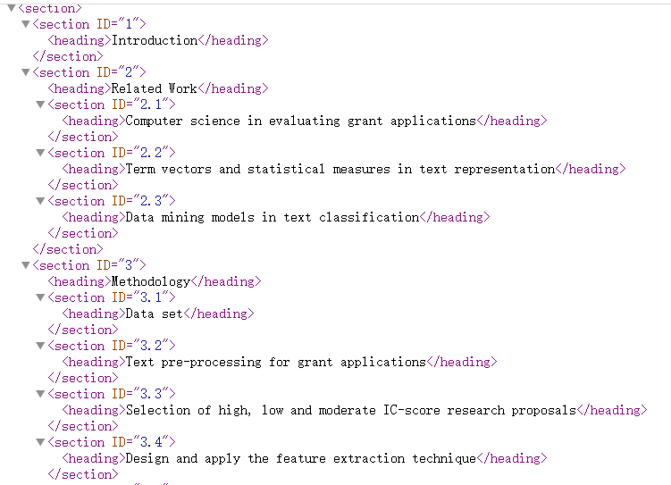
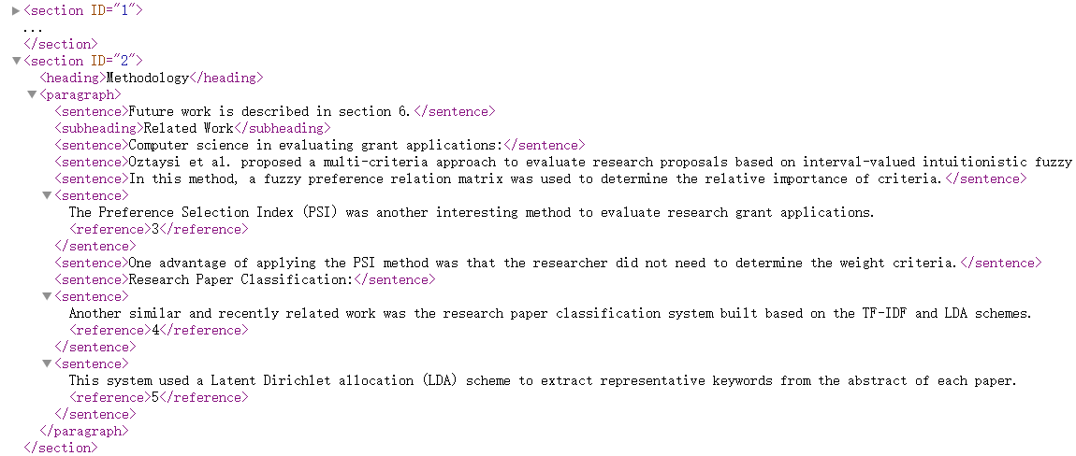
DDM Example
Headings.xml
Deep Document Model

Slide 41
Paper: Accepted ISWC 2023 P&D Track Resource: https://w3id.org/kgcp/PARSE
PARSE: Papers And Relationships Semantic Extraction

Slide 42
Aim of PARSE
Deep Content Analysis
Problem:
Graphs show basic details.
Lack deep content.
Automatic Pipeline
Problem:
Many academic graphs rely on crowdsourcing, lack automated large-scale construction.
Automatic Pipeline
Deep Contents Analysis
Aim of PARSE
Section-wised Parsing
Enhance LLMs
Enhance LLMs:
Problem:
LLMs have AI hallucination, generating false info.
Section-Wise Parsing
Problem:
Existing KGs ignore IMRaD, miss deep paper insights.

Slide 43
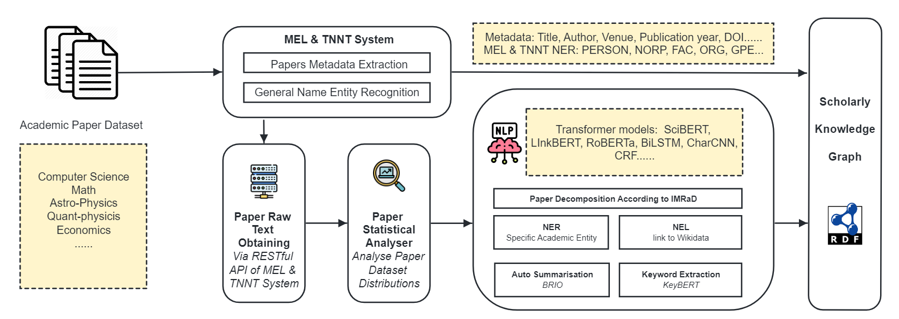
PARSE Pipeline

Slide 44
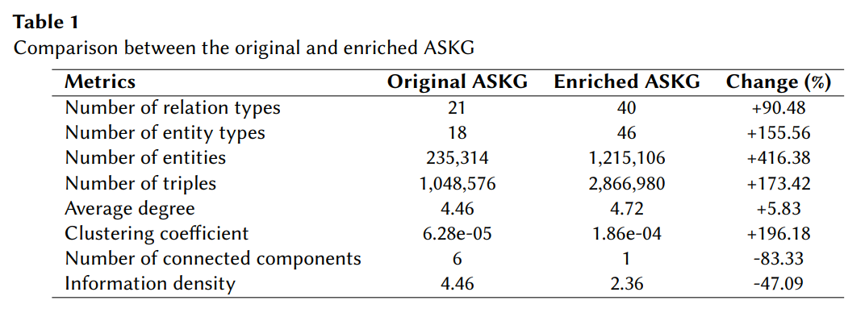
Result of PARSE

Slide 45
ASKG:
ANU Scholarly KG

Slide 46
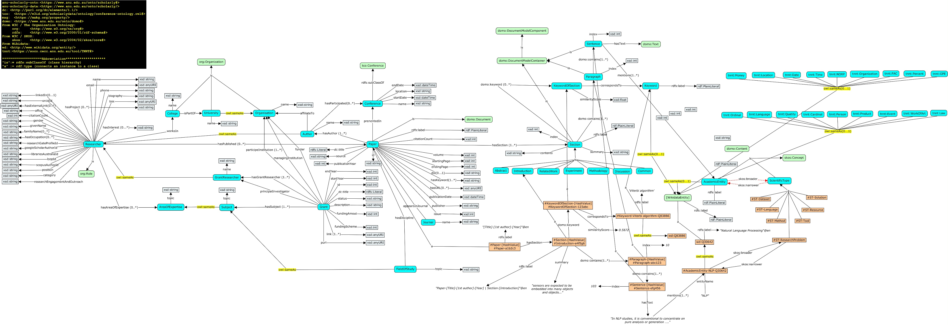
ASKG Ontology Design

Slide 47
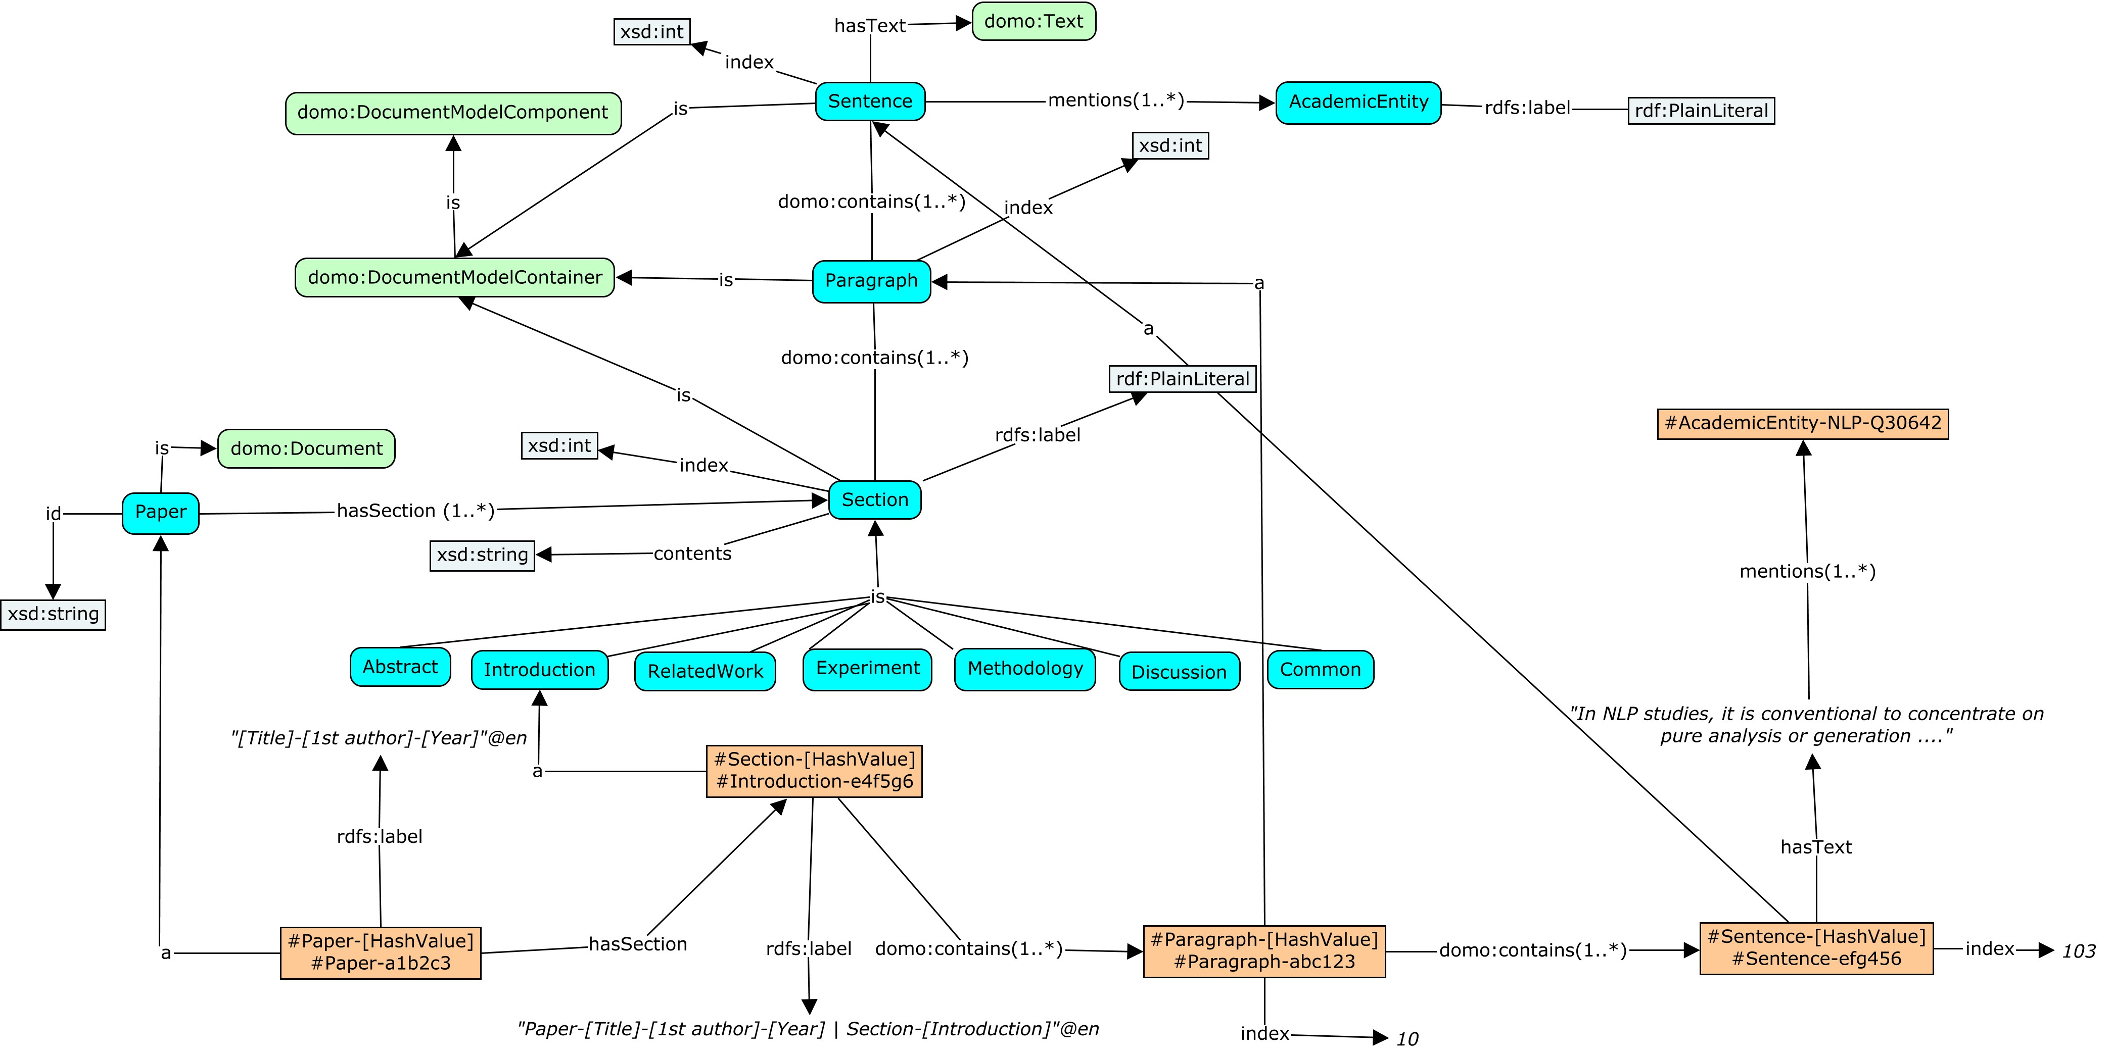

Slide 48
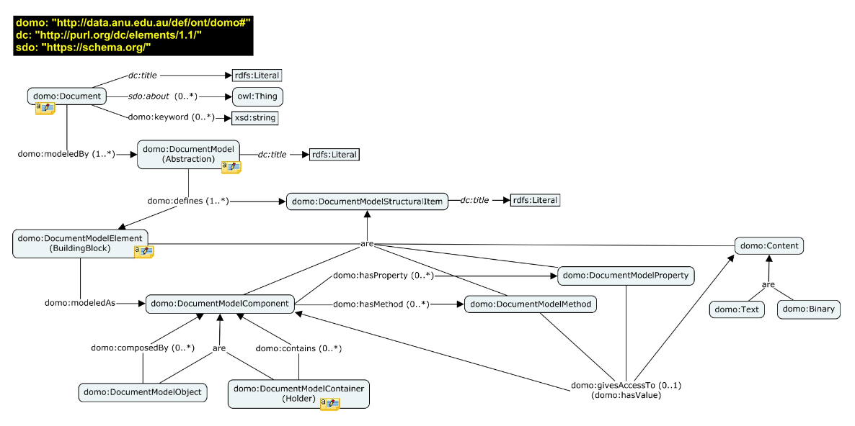
DOMO Ontology Design

Slide 49
KG-LLM Interactions:
Triple Mapping Process

Slide 50
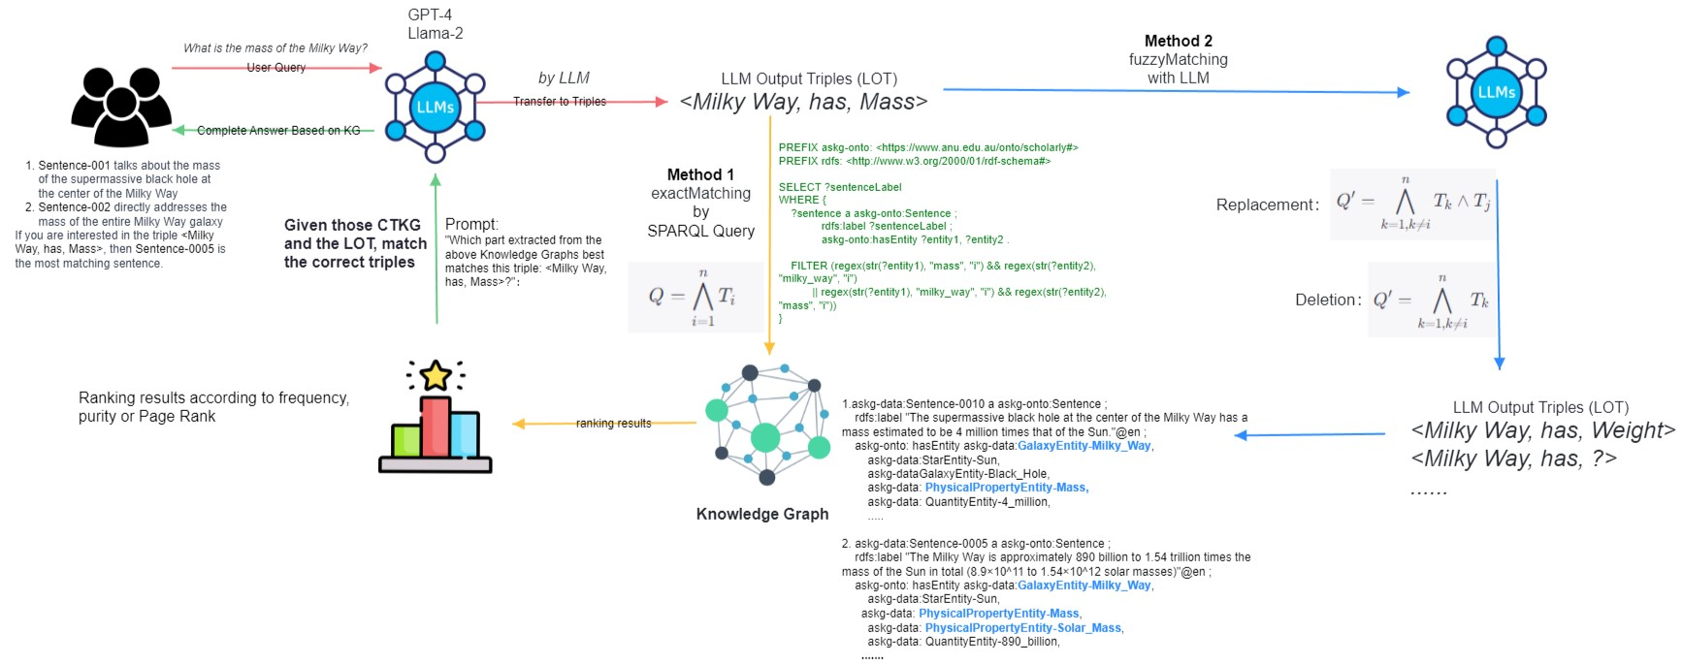
Triple Mapping Process (TMP)

Slide 51
Finance KG and structure.gov.au
John Machin 14 September 2023
Notes:
Finance KG etc

Slide 52
Finance KG project update
Progress
The Year of Several Budget Events survived!
Addition of departments of state / portfolios to site
Small amount of media attention
Lots of internal conversations
Next
Budget summary / landing page for browsing Budget measures
ID service prototype
More formal responsibilities and powers from legislative instruments
Spending some more time on infrastructure?
https://structure.gov.au financeknowledgegraph@finance.gov.au

Slide 53


The Indigenous Data Network by Jamie Feiss, University of Melbourne
The Indigenous Data Network (IDN) - https://idnau.org/
Maintained in the University of Melbourne
A national network of researchers, organisations & departments focused on Indigenous data governance
The IDN data catalogue - https://data.idnau.org/
A Linked Data API – displays catalogues, spatial datasets & vocabularies in the IDN KG
FAIR & CARE scoring of catalogue metadata
Geospatial search using the Loc-I framework
The IDN metadata entry tool - https://idn-au.github.io/idn-metadata-creator/
Educational tool – user-friendly form for creating metadata
Dynamic FAIR & CARE scoring
RDF metadata generation
Notes:
Finance KG and structure.gov.au to go here

Slide 54

Cadastre and Addressing Modernisation Project
Edmond Chuc, Nicholas Car
https://kurrawong.ai

Slide 55
Project
Queensland Department of Resources
Project Goal: Modernise the Addressing system

Slide 56
Challenge
Aging technology
Difficult to update existing data
Fixed schema - not able to keep up with evolving business needs

Slide 57
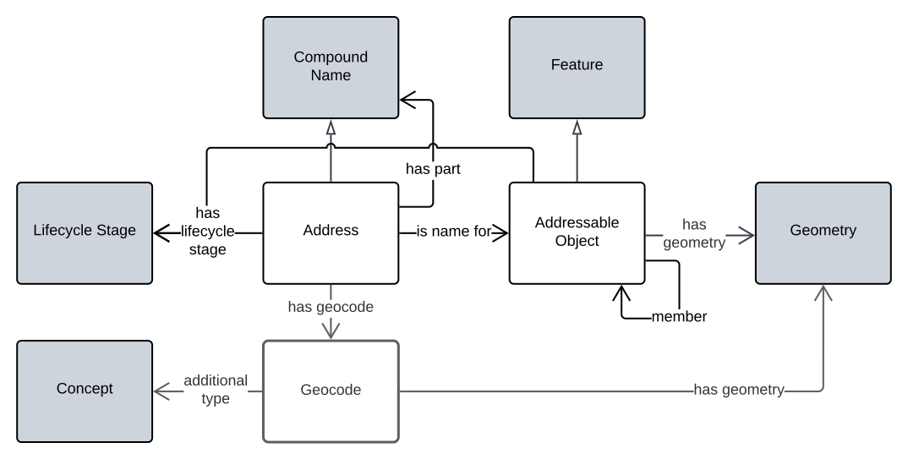
Solution - Conceptual Model
Alignment with
National Address Strategy 2035
and existing international address standards (ISO 19160-1)
Candidate as a national address model
A Semantic Web native model
Best practices built-in (IRI as identifiers, interoperability, FAIR, etc.)

Slide 58
Solution - Physical Model Implementation
Relational system mapped to conceptual model
Python data pipeline - Extract, Transform and Load (ETL)
PostgreSQL
Apache Spark (PySpark)
Python RDFLib toolkit
GraphDB (knowledge graph)

Slide 59
Solution - Result
3 million addresses + roads and geographical names (place names)
Transformation time on a development laptop - ~2 hours
Covered ~85% of the addresses on the initial pass
Bulk data load into knowledge graph (GraphDB)
~23 minutes bulk loading time
Validate data using the SHACL standard
Query data using SPARQL
SPARQL Property Function extension in GraphDB - https://github.com/Kurrawong/graphdb-compound-naming-plugin

Slide 60
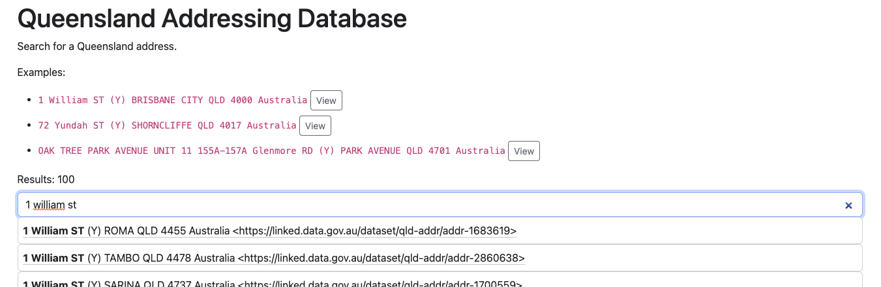
Solution - Demonstration and Testing
Full text search UI

Slide 61
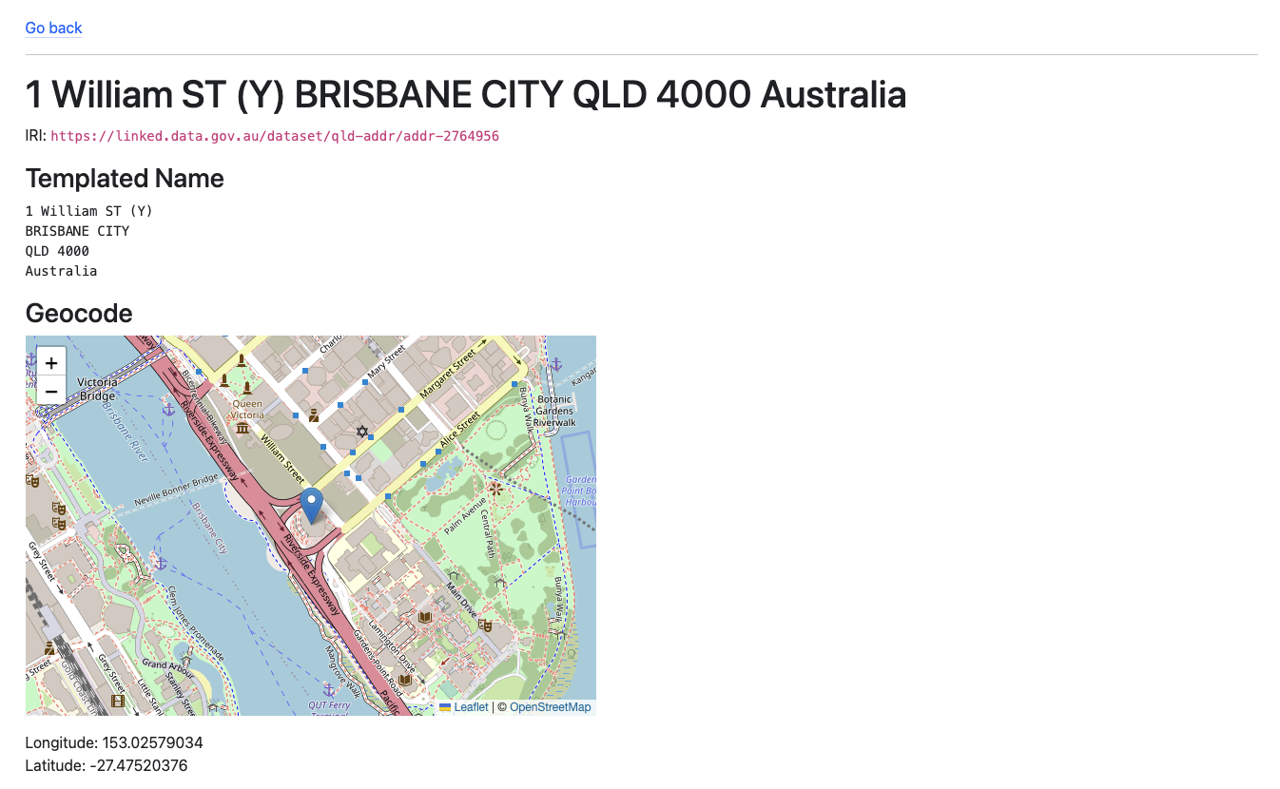
Solution - Demonstration and Testing
View of the Address in different forms
One-liner
Multi-line
Pulling info from external system

Slide 62
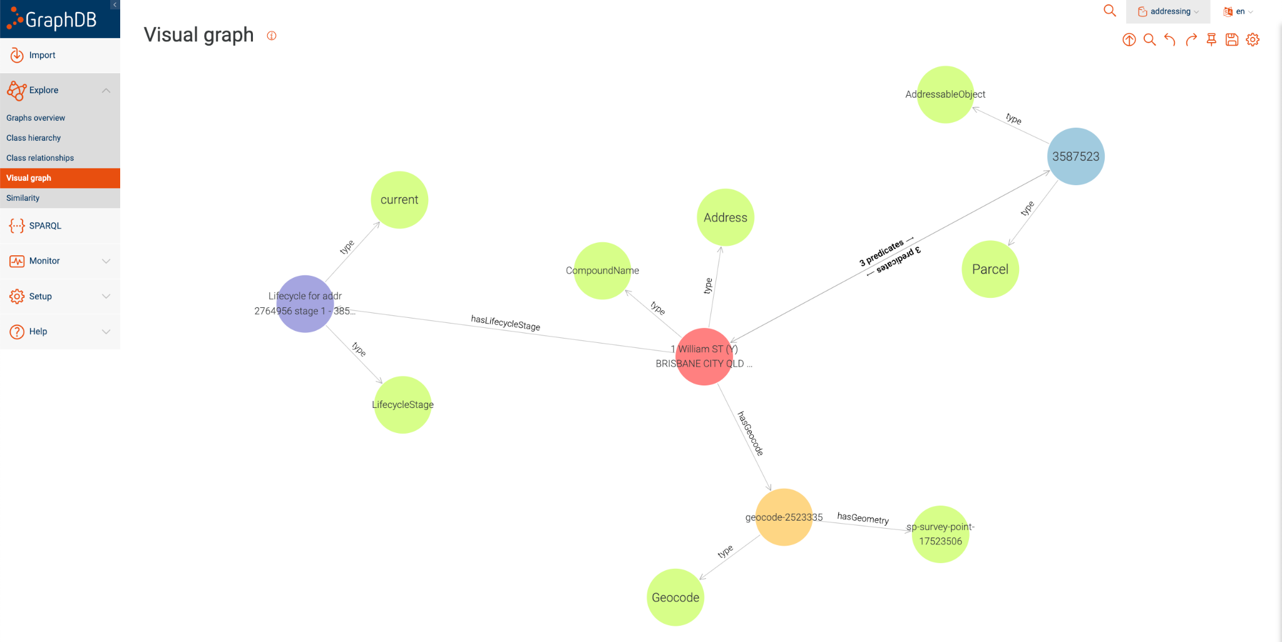
Solution - Demonstration and Testing
Directed graph view of the address with its relationships

Slide 63
Thank you
KurrawongAI - info@kurrawong.ai
For more information - https://kurrawong.ai

Slide 64
Australian Government Linked Data Working Group 2023 Linked Data Showcase
Thanks to all the presenters and the audience
Questions?
Notes:
Close out and thanks slide

